Slide 1
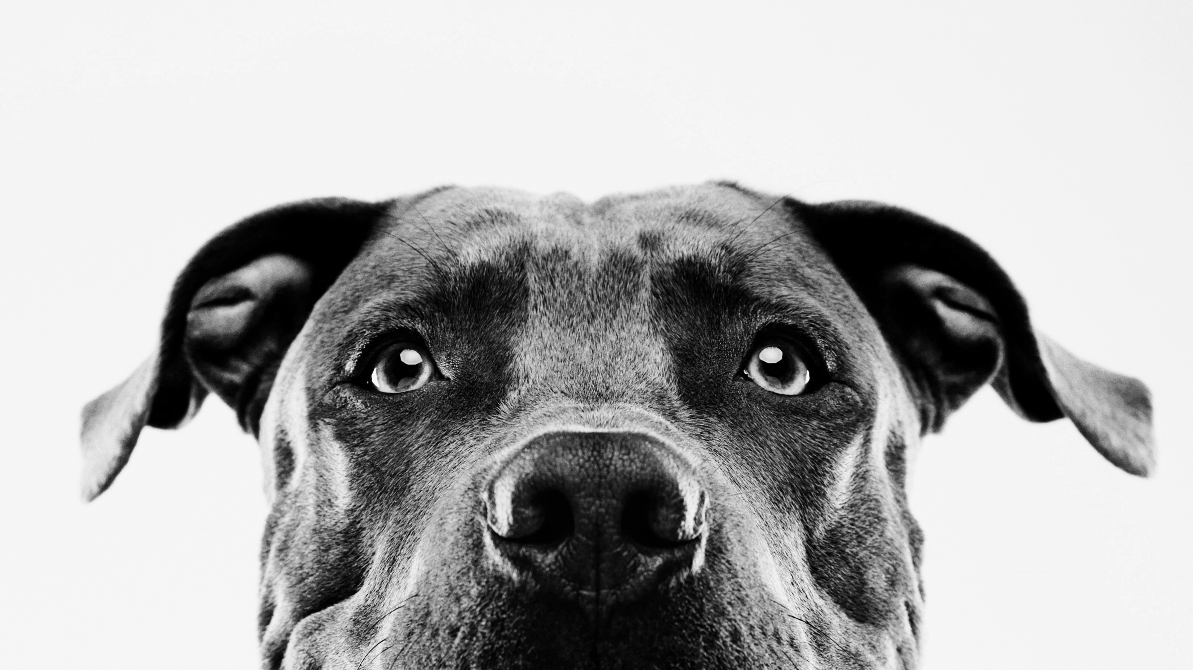
Going to buy for your pet
Data Analytics Process
A CASE Study

Slide 2
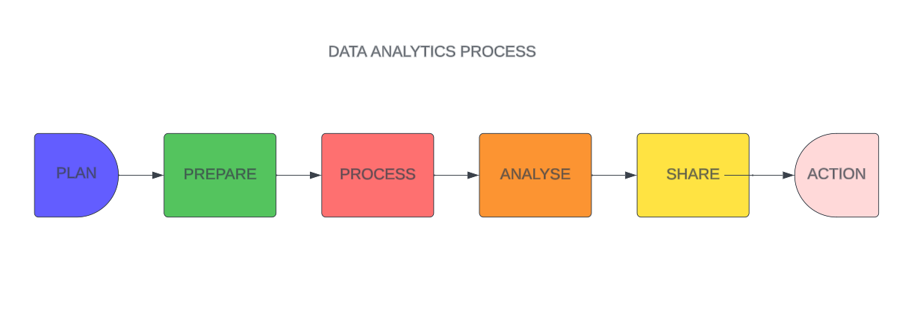

Slide 3

Plan
First phase of the Data Analytics process is the Planning phase (also known as the asking phase).
This phase focuses on what requirements need to be fulfilled and where would these requirements be completed.
This phase is the part of the process where a structured approach (Objective) is defined for the entire Data Analytics process.
Now, looking at the case study, our requirements would be:
What are the necessary equipment to buy for the pet?
Which is the best place available to buy the equipment?
Is there a sale on the equipment?
Only things to be bought should be liked by the pet.
Is the pet fully vaccinated or is there any due medical treatment?

Slide 4

PREPARE
The second phase in the Data Analytics process is the Preparation Phase.
This phase focuses on the utilities required to fulfil the requirements.
Now, looking at the case study, the utilities required are:
The budget required to buy the equipment.
Prioritize what is required the most.
How will I get the finance for buying the equipment.
To make sure that the already brought equipment or food is out of date or not.
To develop a step by step approach to fulfil these requirements.

Slide 5

process
The third phase of the Data Analytics Process is the Process Phase.
This phase will actually involve the execution of the specific analytical tasks.
This phase considers the amount of utilities required from the requirements.
Now, looking at the case study, some of the process involved are:
Buying a collar for the pet depends upon their species, age and weight.
Buying food for the pet depends on the dietary requirements of the pet.
The budget should be reviewed for buying the equipment.

Slide 6
analyse
The fourth phase of the Data Analytics process is the Analyse Phase.
This phase involves the exploration of the tasks to gain new insights and values.
This step is the most important phase in the Data Analytics process as it deals with gaining new information that the provider doesn’t know.
Now, looking at the case study, some of the analysis performed are:
To check the expiration date of the food items before being bought.
To check whether the equipment is necessary for the pet.
To buy diet food according to the pets exercise and activity level.

Slide 7
SHARE
The fifth phase of the Data Analytics process is the Sharing Phase.
This phase ensures that the decision-making process involving the previous steps are correct.
This phase encourages to address any questions that arise while decision making.
Now, looking at the case study, the questions asked may be:
What are the best and healthy food out in the market.
Would this equipment lead to any injury.
Will the medication somehow cause any side-effects.

Slide 8
ACTION
The final phase of the Data Analytics process is the Action phase.
This phase confirms the completion of the task off the list.
This phase involves the implementation of the decisions made while the thinking process.
Now, looking at the case study, the actions committed will be:
Purchasing of the recommended equipment for the pet.
Considering the budget and the availability of the equipment.
Seeking advice or guidance from the pet trainers.
The pet’s behaviour in and around the equipment.

Slide 9
Thank you

